Slide 1
Phishing Website Detection
By: Omri Chen Yosef , Niv Arad
Kaggle notebook

Slide 2
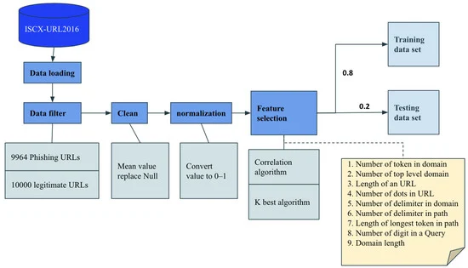
overview

Slide 3
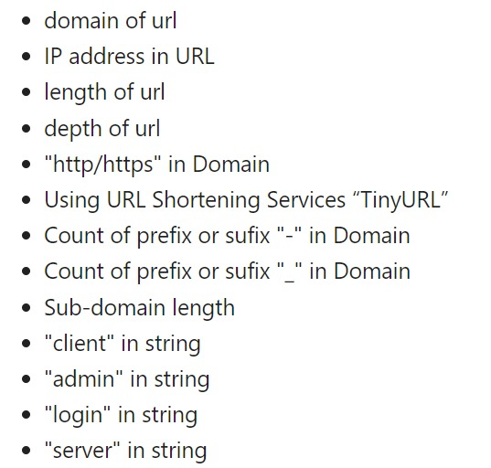
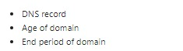
Feature extraction
url - based features
Domain- based features

Slide 4
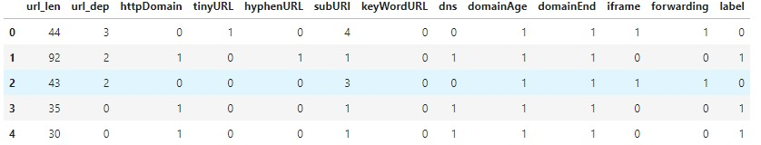
Processed data

Slide 5
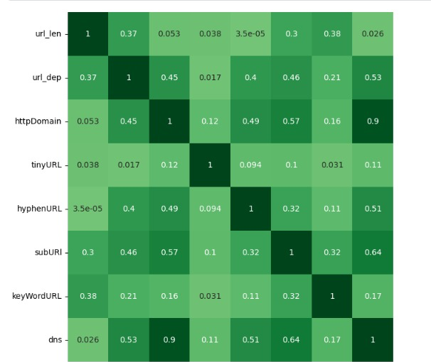
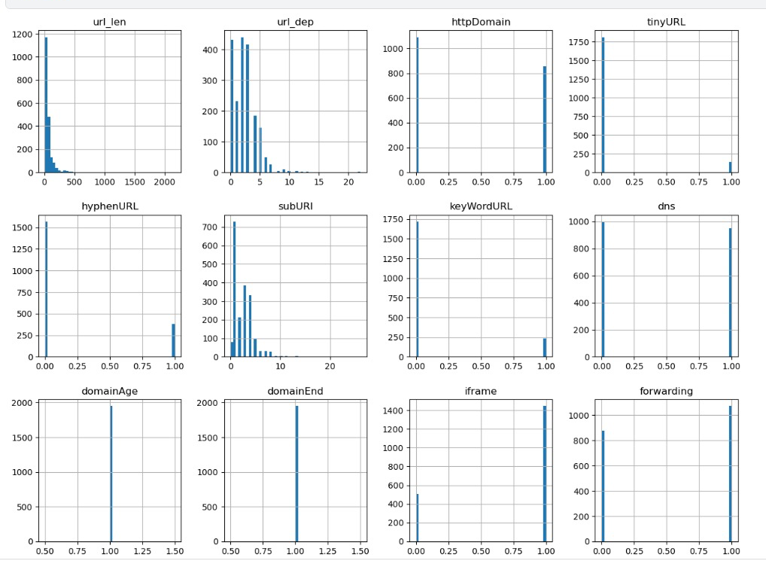
Data Analysis – correlation & Distribution

Slide 6
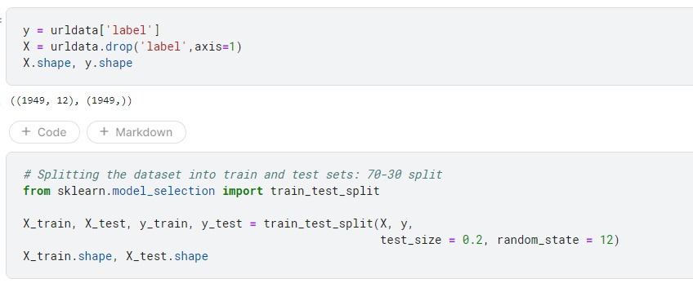
Models & Training
Splitting the data set

Slide 7
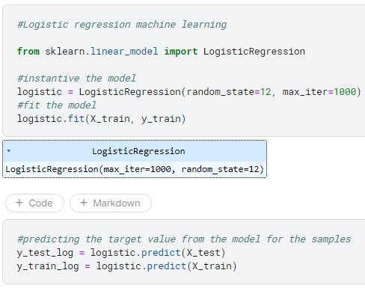
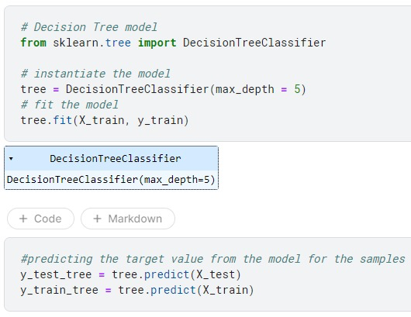
Random forest & logistic regression

Slide 8
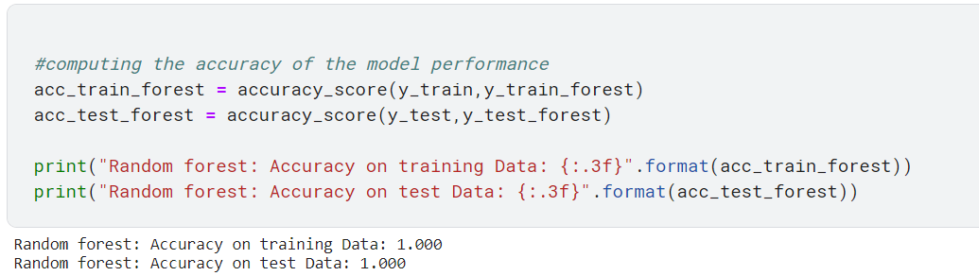
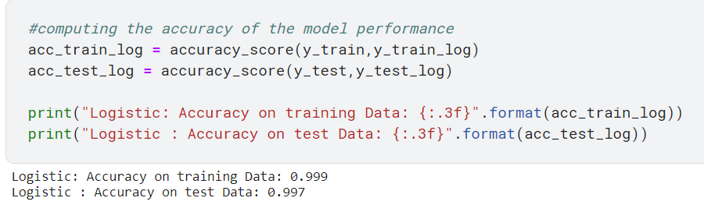
Results
Random forest
logistic regression

Slide 9
Perfect Score - Criticism
After consolation with our mentor Amit Shtekel and explaining him we received a perfect score for our models (1.00) , he gave us new assignment , and it is to compare the price of extracting each feature. After we will drop the expensive features, we will need to check the model again and to see it's results.
We decided to measure the run time of the features after we grouped them to the following categories: parsing , domain and dns registery, content.
After a few runtime measures we have seen that the extraction of the domain and dns registeries are much more expensive - for 1000 rows the parsing features took 0.09 sec but the content features took 500 seconds and the domain/dns features took 620 seconds!!
As a result of this and also because extracting those feature isn’t reliable we decided to drop the content and dns features.

Slide 10
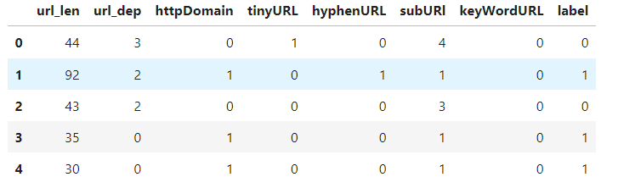
New Processed data

Slide 11
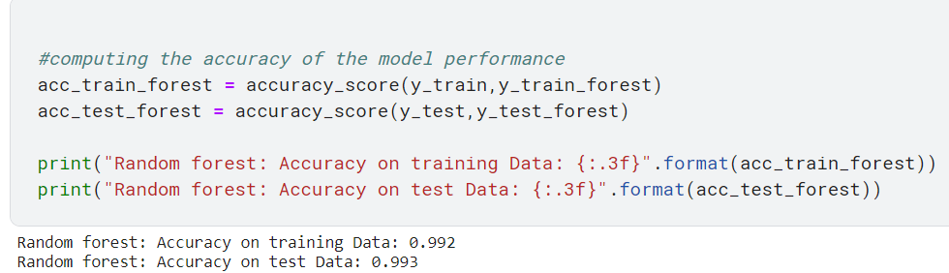
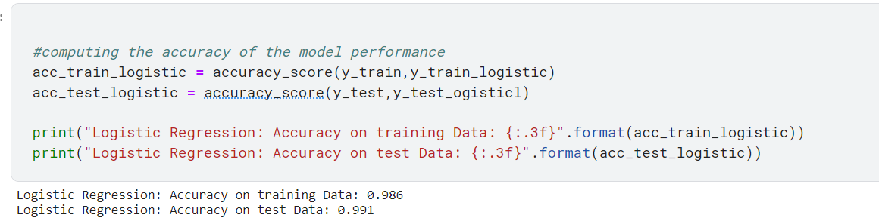
New Results
Random forest
logistic regression

Slide 12
Conclusion
We had a fantastic time exploring the world of ML and utilizing it's power to solve a real-world problem . We learned a lot by going into this world as a riddle needs to be solved and it's final result is not known.
During the project we have been consulting with our mentor Amit Shtekel many times on how to accomplish this project as best as we can - as the project took a few unexpected turns during our work - and therefore we owe him many thanks!

